Slide 1
KCS-501
Pranveer Singh Institute of Technology Kanpur, UP

Slide 2
Structured Query Language (SQL)

Slide 3
Contents
Characteristics of SQL and advantages
SQL Data Types and Commands
SQL operators and their procedure
Views and indexes
SQL Queries and sub queries, nested queries
Aggregate functions
SQL inbuilt functions
Modification in Database
Joins
Union, intersection, set difference

Slide 4
Characteristics of SQL and advantages
SQL is easy to learn.
SQL is used to access data from relational database management systems.
SQL can execute queries against the database.
SQL is used to describe the data.
SQL is used to define the data in the database and manipulate it when needed.
SQL is used to create and drop the database and table.
SQL is used to create a view, stored procedure, function in a database.
SQL allows users to set permissions on tables, procedures, and views

Slide 5
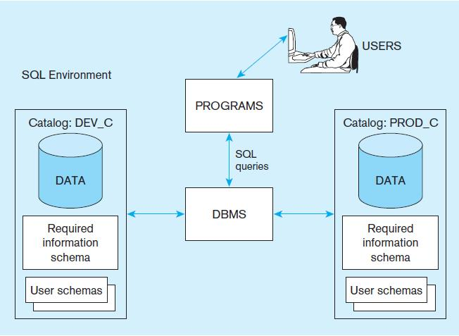
SQL Functionality

Slide 6
Advantages
Faster Query Processing
No Coding Skills
Standardized Language
Portable
Interactive Language
Multiple data views

Slide 7
SQL Environment
Catalog
  A set of schemas that constitute the description of a database
Schema
  The structure that contains descriptions of objects created by a user (base tables, views, constraints)
Data Definition Language (DDL)
  Commands that define a database, including creating, altering, and dropping tables and establishing constraints
Data Manipulation Language (DML)
  Commands that maintain and query a database
Data Control Language (DCL)
  Commands that control a database, including administering privileges and committing data

Slide 8
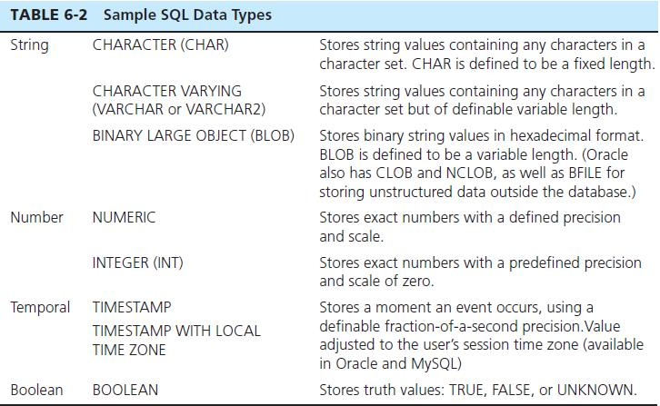
SQL Data Types

Slide 9
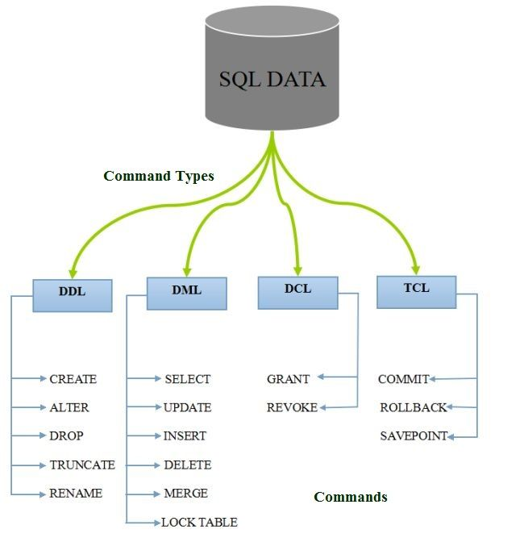
SQL Command

Slide 10
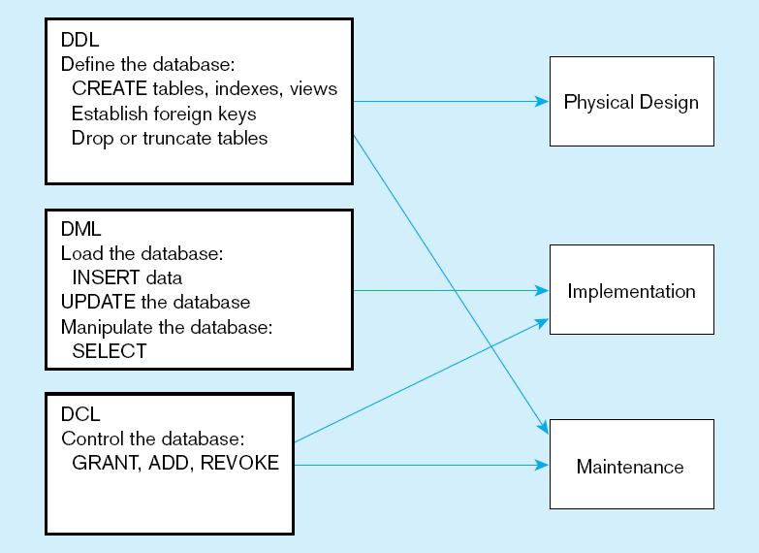
DDL, DML, DCL, and the database development process

Slide 11
SQL Database Definition
Data Definition Language (DDL)
Major CREATE statements:
  CREATE SCHEMA–defines a portion of the database owned by a particular user
  CREATE TABLE–defines a new table and its columns
  CREATE VIEW–defines a logical table from one or more tables or views
Other CREATE statements: CHARACTER SET, COLLATION, TRANSLATION, ASSERTION, DOMAIN

Slide 12
Steps in Table Creation
Identify data types for attributes
Identify columns that can and cannot be null
Identify columns that must be unique (candidate keys)
Identify primary key–foreign key mates
Determine default values
Identify constraints on columns (domain specifications)
Create the table and associated indexes

Slide 13
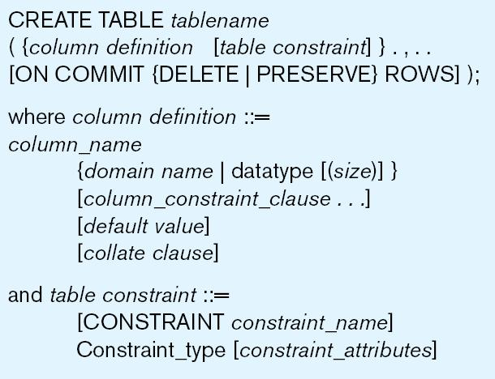
General syntax for CREATE TABLE statement used in data definition language

Slide 14
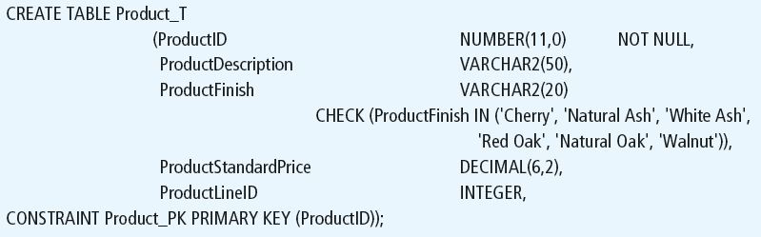
SQL command syntax

Slide 15
Non-nullable specification
Primary keys can never have NULL values
Identifying primary key

Slide 16
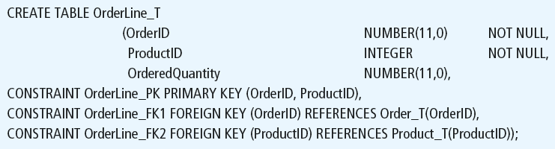
Non-nullable specifications
Primary key
Some primary keys are composite– composed of multiple attributes

Slide 17
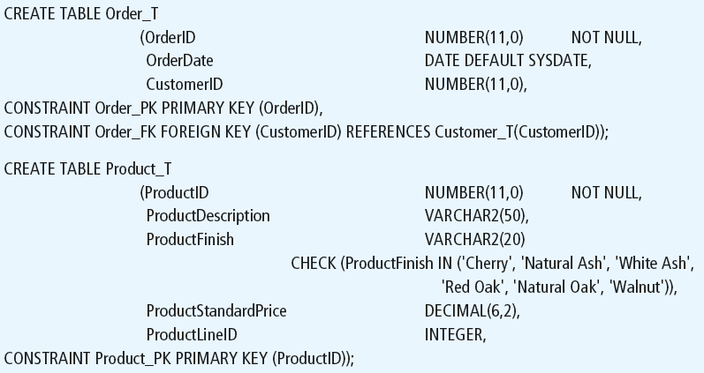
Controlling the values in attributes
Default value
Domain constraint

Slide 18
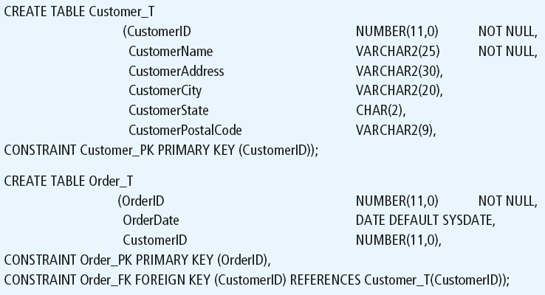
Identifying foreign keys and establishing relationships
Primary key of parent table
Foreign key of dependent table

Slide 19



Insert Statement
Adds one or more rows to a table
Inserting into a table
Inserting a record that has some null attributes requires identifying the fields that actually get data
Inserting from another table

Slide 20
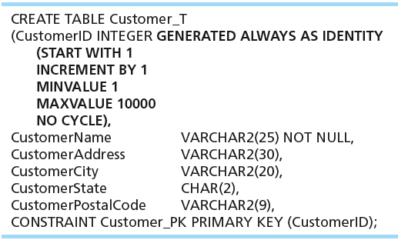
Creating Tables with Identity Columns
Introduced with SQL:2008
Inserting into a table does not require explicit customer ID entry or field list
  INSERT INTO CUSTOMER_T VALUES ( ‘Contemporary Casuals’, ‘1355 S. Himes Blvd.’, ‘Gainesville’, ‘FL’, 32601);

Slide 21
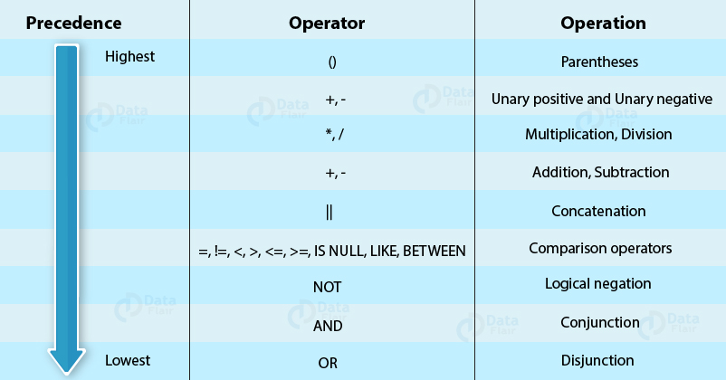
SQL operator and their procedure

Slide 22
Operator procedure examples
Operator: +/-
Syntax:
<expression> +/- <expression>
Description: Arithmetic addition returns the sum of the two operands.
Comparison Operators(=)
Syntax:
SELECT*FROM Employee WHERE age=50;
Operator: <>, !=
Description: Not equal to operator
Syntax:
SELECT*FROM Employee WHERE age<>50; or SELECT*FROM Employee WHERE age!=50;

Slide 23
Conti.
Logical operator : OR, AND, NOT
Syntax:
1. WHERE condition1 OR condition2
Description: The result is TRUE if either one of the two conditions (condition1 or condition2) is TRUE, otherwise FALSE.
2. WHERE condition1 AND conditon2
Description: The result is TRUE only if both the conditions are TRUE together, otherwise FALSE.
3. WHERE NOT condition
Description: It is used before a condition to negate it. That is, if a condition holds TRUE then this operator will make it FALSE (in the output) or if a condition is FALSE, it will make it TRUE in the output.

Slide 24
Conti..
Set operators combine multiple queries and return a single result set in output.
Operator: UNION
Description: This operator combines the outputs of two or more SQL select statements or query expressions.
Operator: UNION ALL
Description: This operator also combines all the outputs of two or more SQL select statements or query expressions but it also includes all duplicate rows.
Operator: INTERSECT
Description: This operator combines the outputs of two or more SQL select statements or query expressions and returns all the common rows.
Operator: EXCEPT
Description: This operator takes the result from the first query, removes the rows selected by the second query and gives the output. It is also referred to as MINUS.

Slide 25
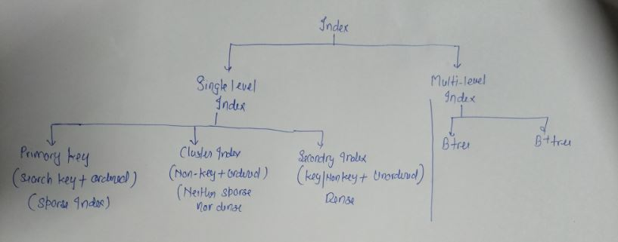
Index

Slide 26
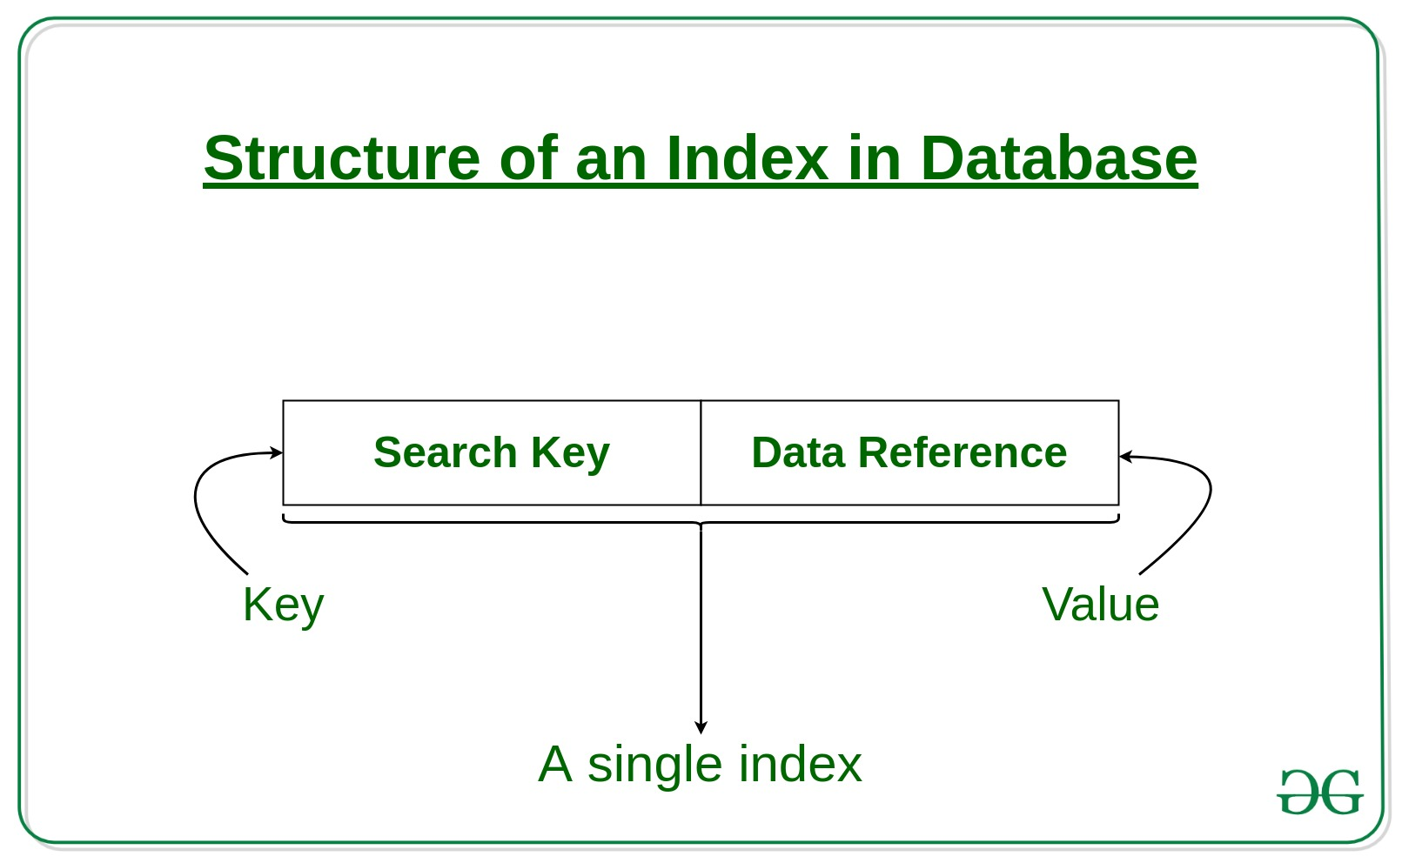
Conti..

Slide 27
Index operation
Creating an Index
syntax : CREATE INDEX index ON TABLE column;
Multiple Index:
Syntax:
CREATE INDEX index
ON TABLE (column1, column2,.....);
Removing an Index
Syntax:
DROP INDEX index
Altering an Index:
Syntax
ALTER INDEX IndexName
ON TableName REBUILD;

Slide 28
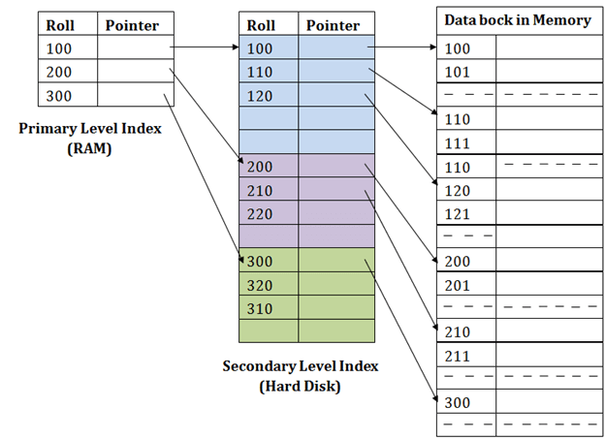
Primary vs Secondary Index

Slide 29
Cluster Index
Note: Cluster index neither pure sparse nor pure dense index, it is the combination of both.
Clustered index is created only when both the following conditions satisfy –
->The data or file, that you are moving into secondary memory should be in sequential or sorted order.
->There should be non key value, means the data may be repeated.

Slide 30
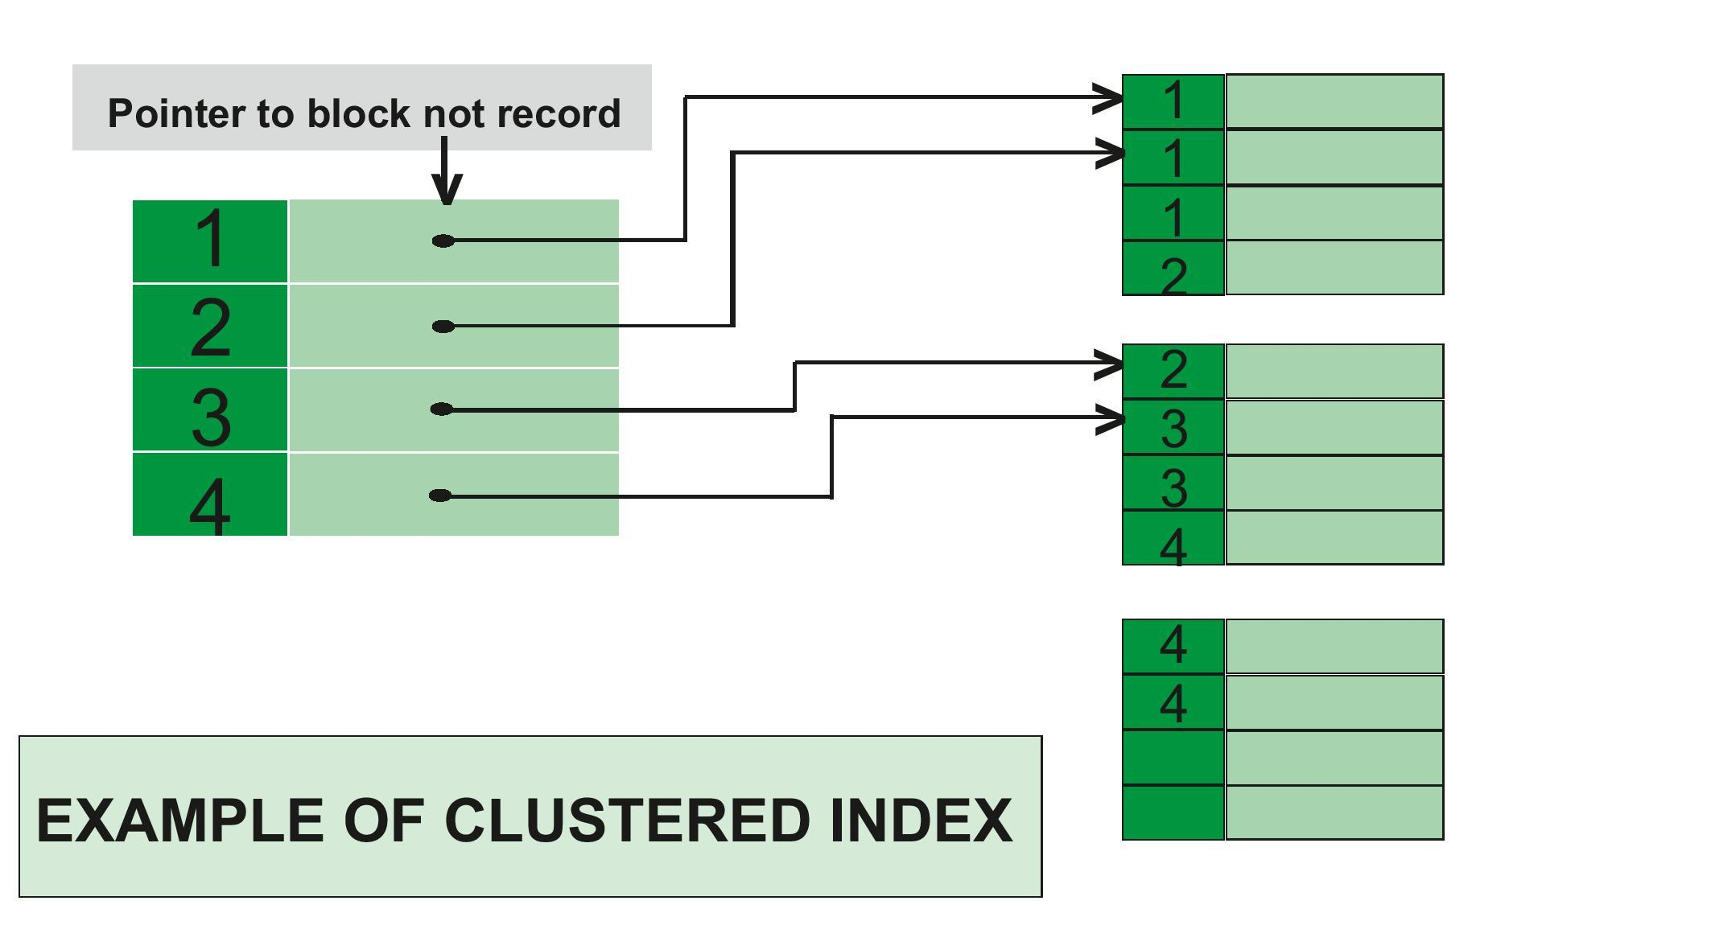
Conti..

Slide 31
SQL Views:
In SQL, a view is a virtual table based on the result-set of an SQL statement.
A view contains rows and columns, just like a real table. The fields in a view are fields from one or more real tables in the database.
Create a view syntax:
CREATE VIEW view_name AS
SELECT column1, column2, ...
FROM table_name
WHERE condition;
Note: A view always shows up-to-date data! The database engine recreates the data, using the view's SQL statement, every time a user queries a view.

Slide 32
SQL queries, sub queries and nested queries
Used for queries on single or multiple tables
Clauses of the SELECT statement:
  SELECT
    List the columns (and expressions) to be returned from the query
  FROM
    Indicate the table(s) or view(s) from which data will be obtained
  WHERE
    Indicate the conditions under which a row will be included in the result
  GROUP BY
    Indicate categorization of results
  HAVING
    Indicate the conditions under which a category (group) will be included
  ORDER BY
    Sorts the result according to specified criteria

Slide 33
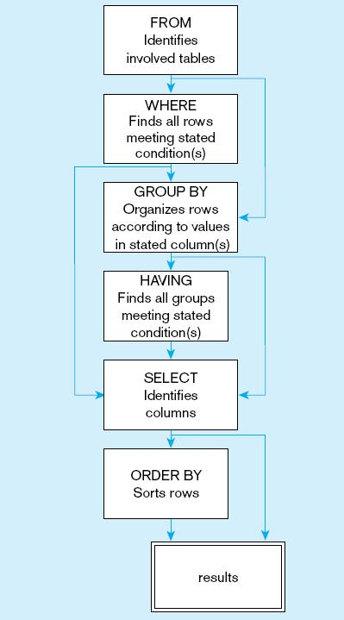
  SQL statement processing order

Slide 34
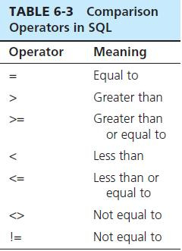

SELECT Example
Find products with standard price less than $275

Slide 35
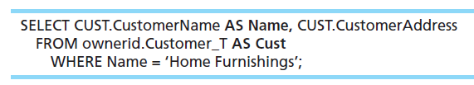
SELECT Example Using Alias
Alias is an alternative column or table name
Here, CUST is a table alias and Name is a column alias

Slide 36
SELECT Example Using a Function
Using the COUNT aggregate function to find totals
  SELECT COUNT(*) FROM ORDERLINE_T
  WHERE ORDERID = 1004;
  Note: with aggregate functions you can’t have single-valued columns included in the SELECT clause, unless they are included in the GROUP BY clause.

Slide 37
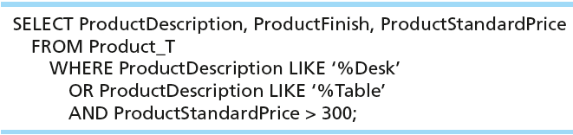
SELECT Example–Boolean Operators
AND, OR, and NOT Operators for customizing conditions in WHERE clause
Note: the LIKE operator allows you to compare strings using wildcards. For example, the % wildcard in ‘%Desk’ indicates that all strings that have any number of characters preceding the word “Desk” will be allowed.

Slide 38
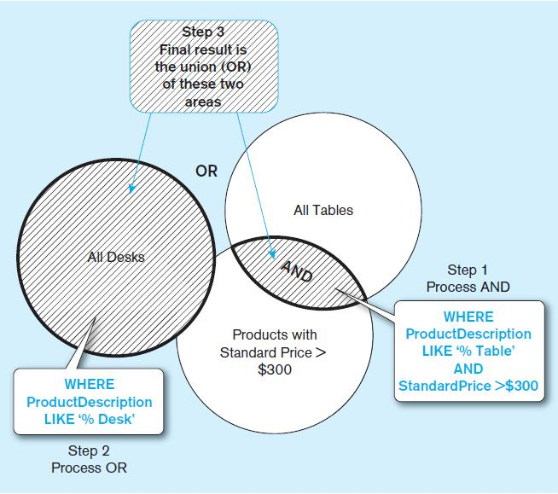
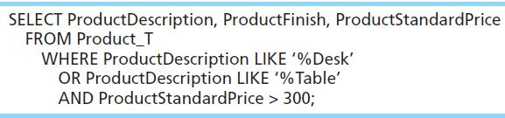
Boolean query A without use of parentheses
By default, processing order of Boolean operators is NOT, then AND, then OR

Slide 39
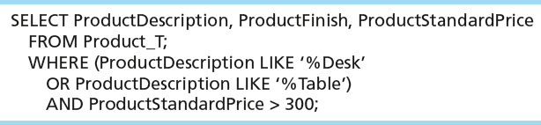
SELECT Example–Boolean Operators
With parentheses…these override the normal precedence of Boolean operators
With parentheses, you can override normal precedence rules. In this case parentheses make the OR take place before the AND.

Slide 40
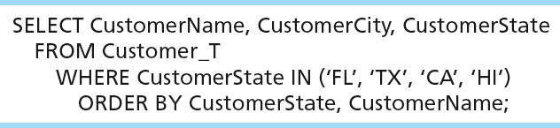
Sorting Results with ORDER BY Clause
Sort the results first by STATE, and within a state by the CUSTOMER NAME
Note: the IN operator in this example allows you to include rows whose CustomerState value is either FL, TX, CA, or HI. It is more efficient than separate OR conditions.

Slide 41

Categorizing Results Using GROUP BY Clause
For use with aggregate functions
  Scalar aggregate: single value returned from SQL query with aggregate function
  Vector aggregate: multiple values returned from SQL query with aggregate function (via GROUP BY)
  You can use single-value fields with aggregate functions if they are included in the GROUP BY clause.

Slide 42
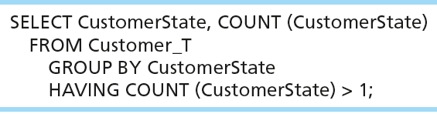
Qualifying Results by Categories
Using the HAVING Clause
For use with GROUP BY
Like a WHERE clause, but it operates on groups (categories), not on individual rows. Here, only those groups with total numbers greater than 1 will be included in final result.

Slide 43
Sub queries:
A subquery is a SQL query nested inside a larger query.
A subquery may occur in :
  - A SELECT clause
  - A FROM clause
  - A WHERE clause
The subquery can be nested inside a SELECT, INSERT, UPDATE, or DELETE statement or inside another subquery.
A subquery is usually added within the WHERE Clause of another SQL SELECT statement.
You can use the comparison operators, such as >, <, or =. The comparison operator can also be a multiple-row operator, such as IN, ANY, or ALL.
A subquery is also called an inner query or inner select, while the statement containing a subquery is also called an outer query or outer select.
The inner query executes first before its parent query so that the results of an inner query can be passed to the outer query.

Slide 44
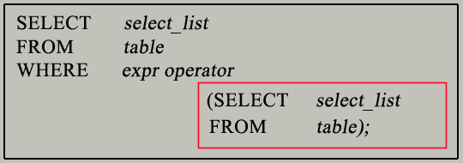
Conti..
You can use a subquery in a SELECT, INSERT, DELETE, or UPDATE statement to perform the following tasks:
Compare an expression to the result of the query.
Determine if an expression is included in the results of the query.
Check whether the query selects any rows.
Syntax

Slide 45
Conti..
The subquery (inner query) executes once before the main query (outer query) executes.
The main query (outer query) use the subquery result.

Slide 46
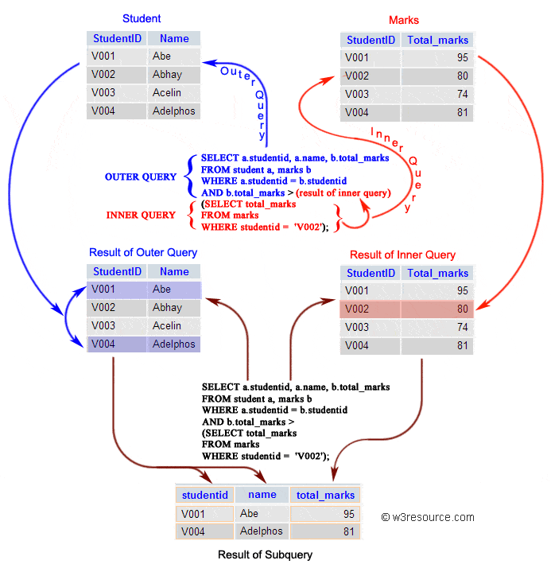

Slide 47
Nested subquery:
In nested queries, a query is written inside a query.
The result of inner query is used in execution of outer query.
Nested query is executed for the selection of every record of outer query.
Lets understand the concept of nested subquery by taken an example.
Let’s see how the IN operator works. In this example, you’ll calculate the average number of students in classes where the teacher teaches History or English-

Slide 48
Conti..
SELECT AVG(number_of_students)
FROM classes
WHERE teacher_id IN (SELECT id
FROM teachers
WHERE subject = 'English' OR subject = 'History');
Here you use a subquery to select only those teacher IDs that correspond to teachers of English or History. Note that our subquery returns a list of values, i.e. a table with one column (id) and multiple rows that satisfy the condition of the inner query.
Then, in our outer query, you calculate the average number of students only for those classes that satisfy the above condition. For every teacher_id, the IN operator checks if that ID is present in the table returned by the inner query; this ensures that only the classes corresponding to these teachers are considered in the calculation.

Slide 49
Aggregate function and SQL inbuilt function:
An aggregate function performs a calculation on a set of values.
Aggregate function returns a single value.
Aggregate functions ignore null values.
Aggregate functions are often used with the GROUP BY clause of the SELECT statement.
Many aggregate function are used in SQL, some of important Aggregate function are given below.
COUNT() Syntax:
SELECT COUNT(column_name)
FROM table_name
WHERE condition;

Slide 50
Conti..
2. AVG() Syntax:
SELECT AVG(column_name)
FROM table_name
WHERE condition;
3. SUM() Syntax:
SELECT SUM(column_name)
FROM table_name
WHERE condition;
4. MIN() Syntax
SELECT MIN(column_name)
FROM table_name
WHERE condition;
5. MAX() Syntax
SELECT MAX(column_name)
FROM table_name
WHERE condition;

Slide 51
Join:
A JOIN clause is used to combine rows from two or more tables, based on a related column between them.
Different Types of SQL JOINs
Here are the different types of the JOINs in SQL:
(INNER) JOIN: Returns records that have matching values in both tables
LEFT (OUTER) JOIN: Returns all records from the left table, and the matched records from the right table
RIGHT (OUTER) JOIN: Returns all records from the right table, and the matched records from the left table
FULL (OUTER) JOIN: Returns all records when there is a match in either left or right table

Slide 52
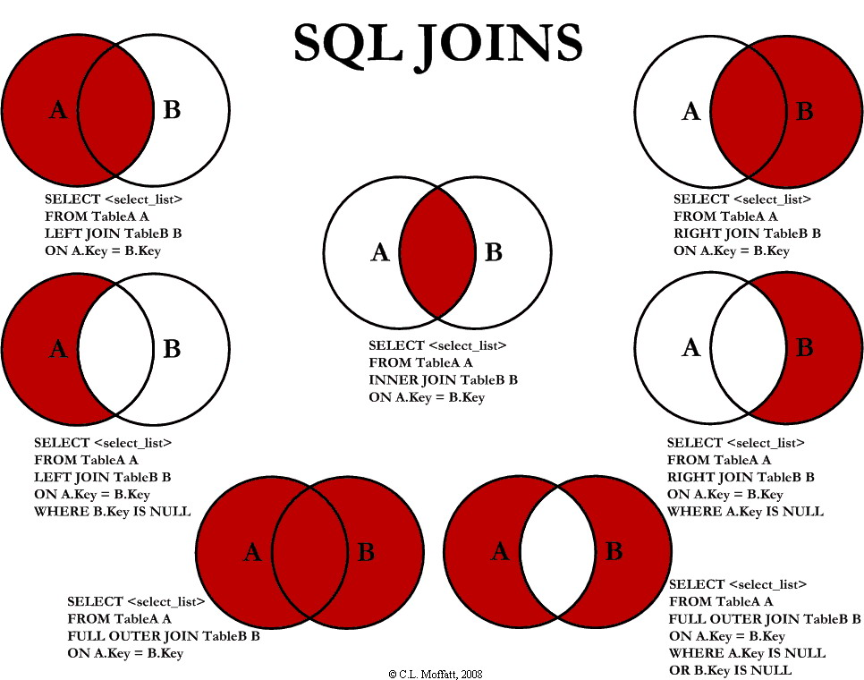
Join:

Slide 53
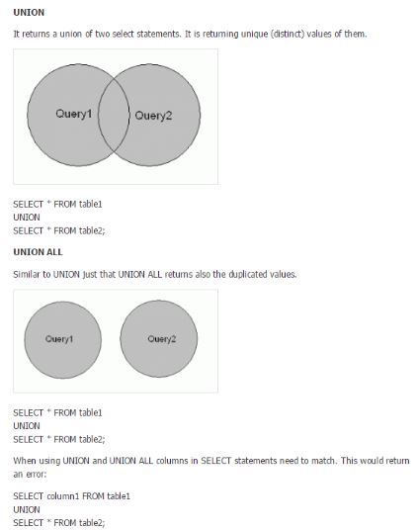
Union and Union All:

